Slide 1



Smart India Hackathon
Team EPOX
Automatic Assessment of Pavement condition based on road photographs

Slide 2
Problems which our solution will solve
Difficulty in data interpretation between the government, the users and the tech providers. We offer a CONDUIT between the above parties
No clarity in the general public regarding the information which needs to be conveyed to the government when lodging a complain
Inflexibility in number of features. The number of defects in may vary according to the region and organization
Types of rural roads may vary according to the region
Human intervention required. Our method will introduce complete automation but will allow fine tuning according to the inspectors
Efficiency in M-R(Maintenance and Rehabilitation) and better utilization of resources and planning
No standardization of PCI

Slide 3

Focus Points of Our Solution
Standardizing PCI through mathematical justification
Creating a CONDUIT OF INFORMATION between the users, the government and us.
Empowering the people
Extremely accessible and user-friendly app
Keeping government database updated through crowd-sourcing
Allowing fast and concise information access and maintenance for the govt. with our dashboard
Reducing cost of M-R
Using latest SOTA computer vision models to ensure ease in future proofing and further updates

Slide 4
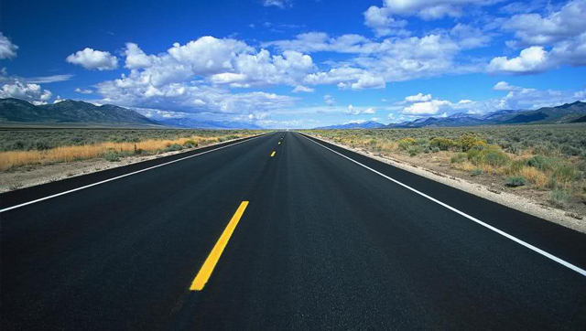
Citizens
+ MoRD
+ Technology
= Better Roads

Slide 5



Project

Slide 6
APP DEMO

Slide 7


Slide 8


Slide 9
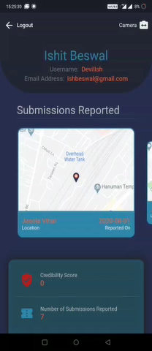

Slide 10
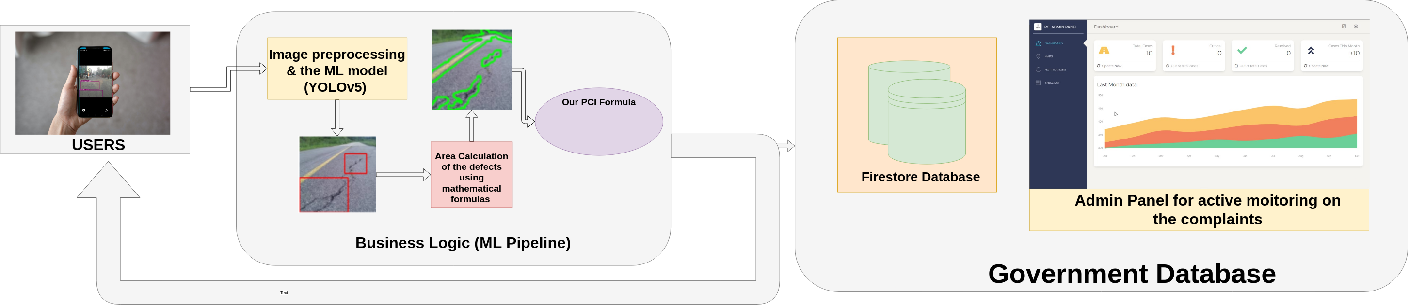
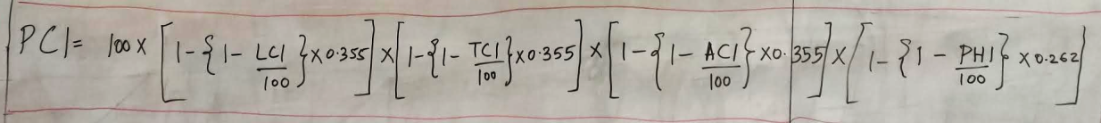
Workflow/Pipeline

Slide 11
Why is our PCI formula special?

Slide 12

Why is our PCI formula special?
Mathematically sound
Empirically Tested
Independent of the underlying computer vision algorithm
Allows feature independence
Requires no human intervention for its components
Standardizes the metric!!

Slide 13

Questions / Suggestions

